Slide 1

Go, change the world
RV College of
Engineering
Design Thinking
Department of CSE
Phase I

Slide 2

Go, change the world
RV College of
Engineering
Team Details
Team Members
Prasanna Bhat
Ratan Narayan Hegde
R Vijay Chiranjith Reddy
Rohit Parashuram Myali
Mentors
Prof Rajashree and Prof Prapulla

Slide 3
Go, change the world
RV College of
Engineering
Team Members Responsibility
Prasanna Bhat :Designing the Prototype.
Ratan Narayan Hegde :Designing the Prototype
R Vijay Chirajith Reddy :Organising and data collection
Rohit Parashuram myali :Documentation and Presentation

Slide 4
Go, change the world
RV College of
Engineering
Empathy
Our target audience is the youth . Hence we decided to prepare google form and circulate it to some whatsapp groups and to students studying in different streams of education.
We have met different job holders and discussed about the smartphone addiction, hindering their daily curriculums in offices.
Majority of them responded that smart phone was helping them to lead a easier life but also it was killing their time and management skills. They were not able to accomplish their tasks in the give time period and of which major reason was smartphone addiction.

Slide 5
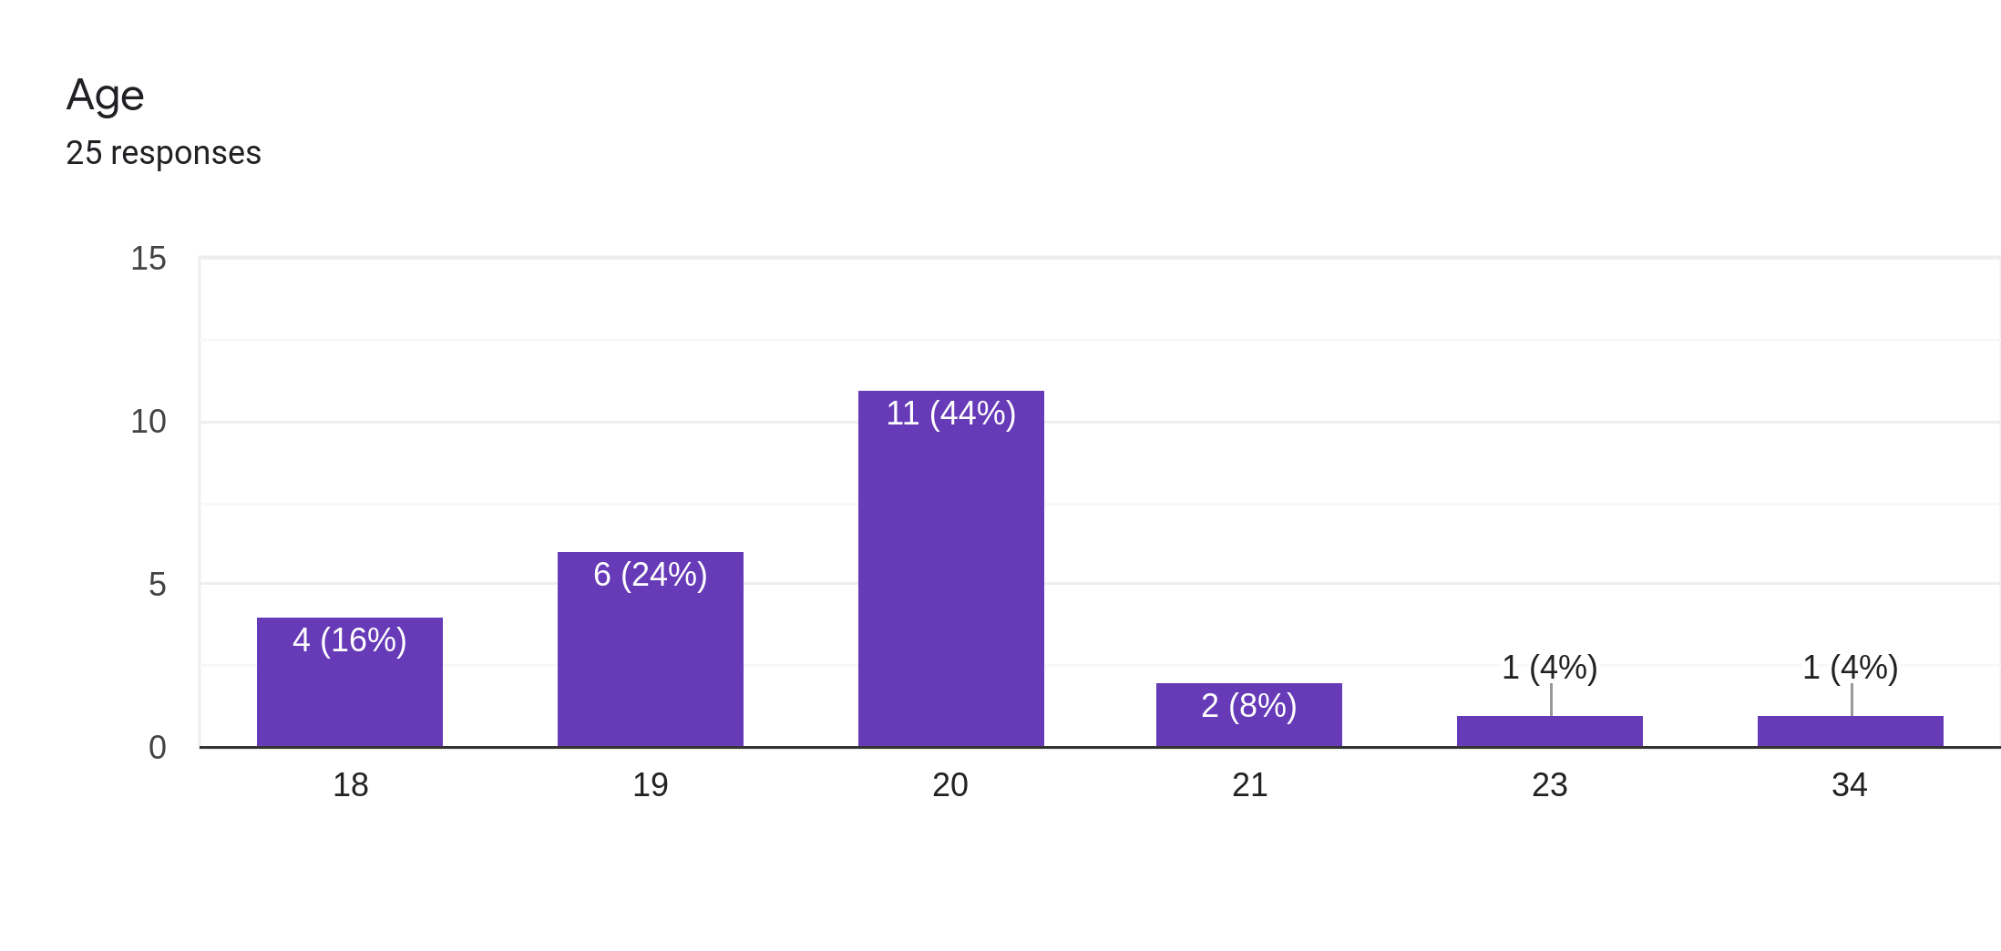
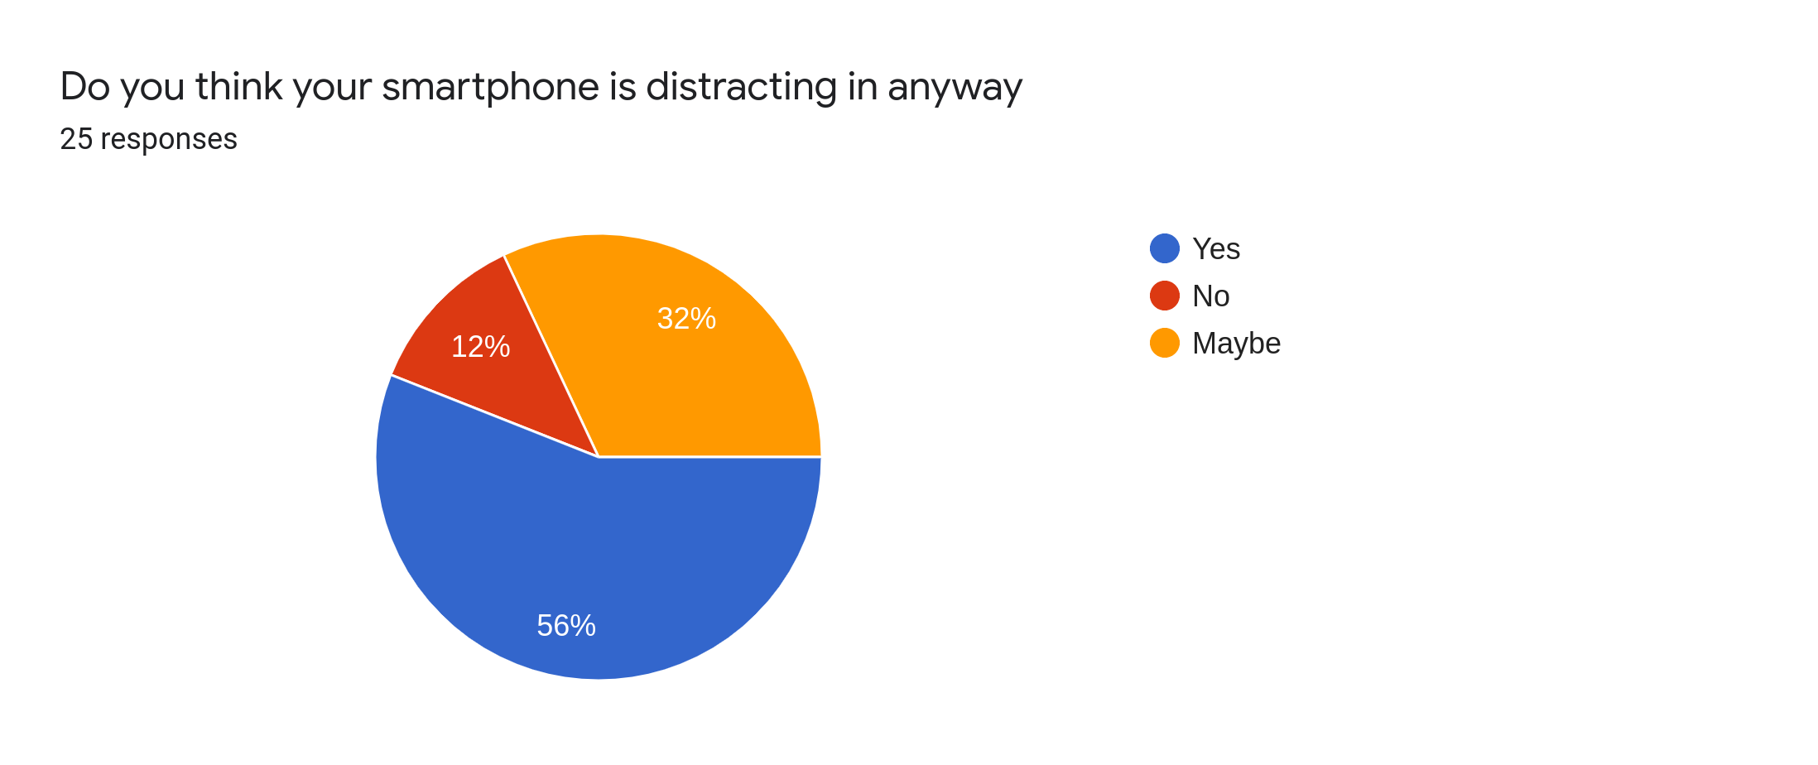
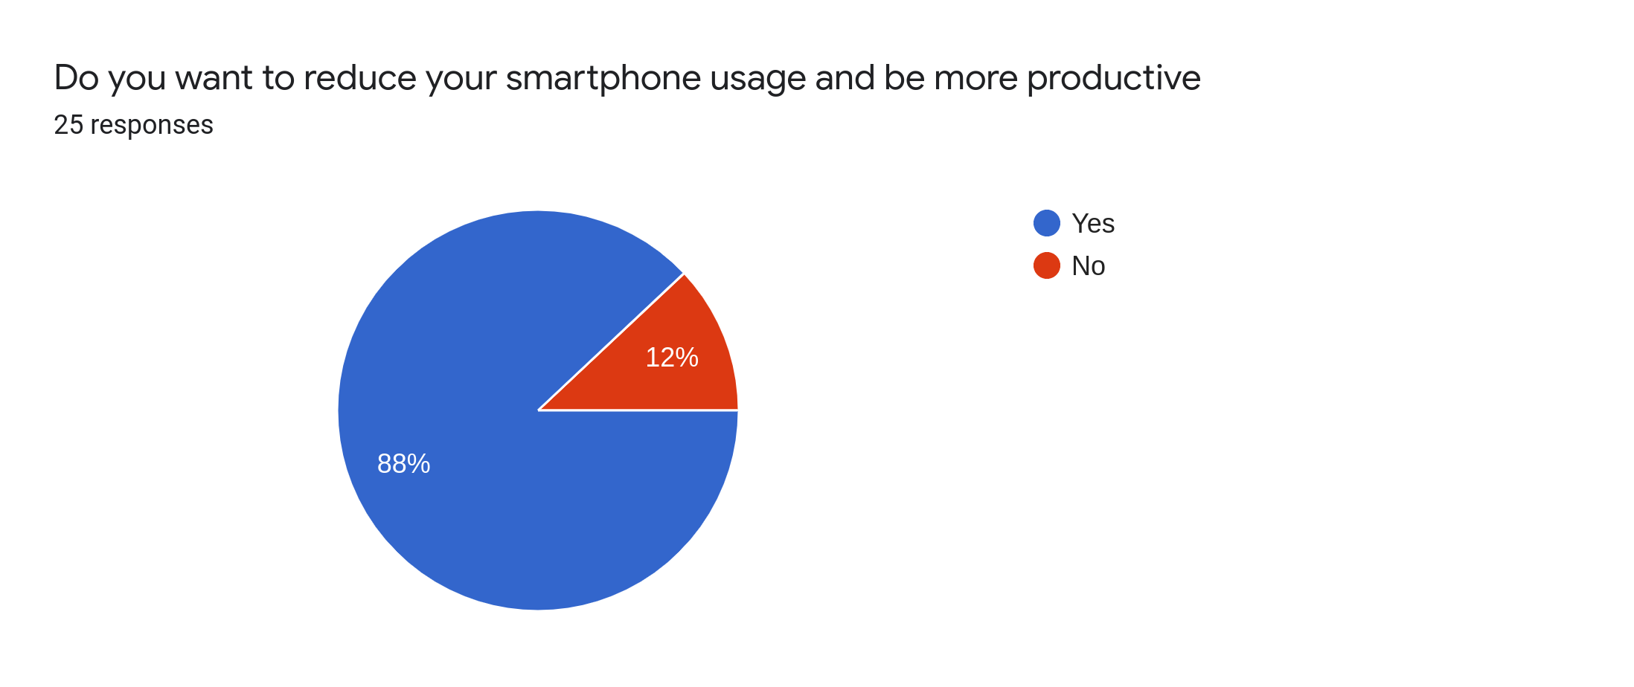
Go, change the world
RV College of
Engineering
Empathy
Analysis of Smartphone - google form summary

Slide 6
Go, change the world
RV College of
Engineering
Empathy- Evidences
Sample evidences- Videos/Images/Audio

Slide 7
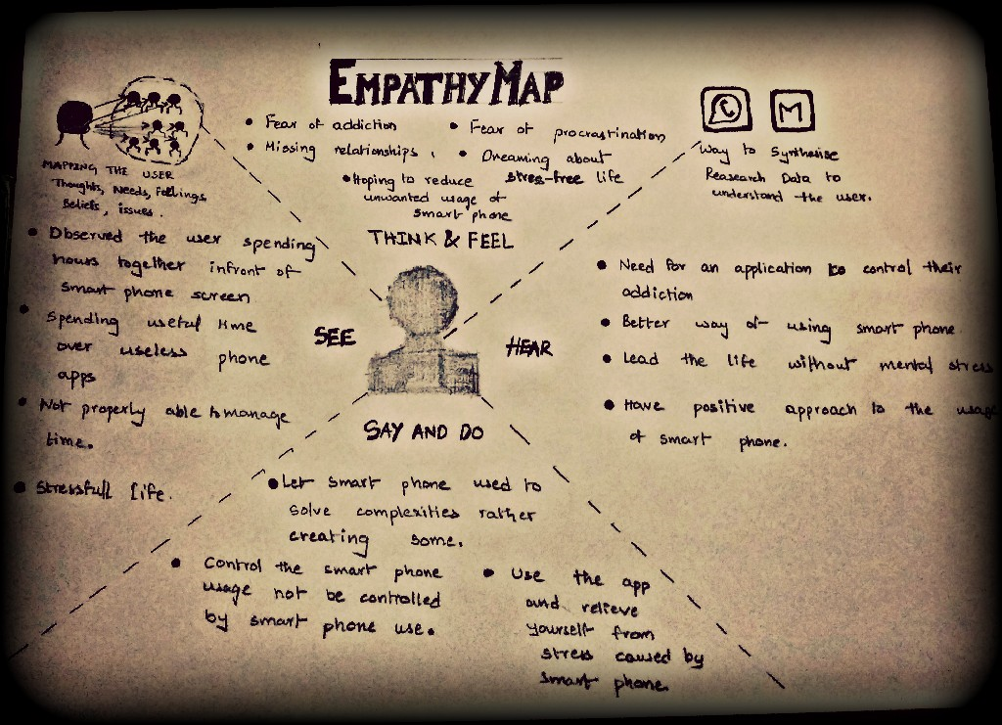
Go, change the world
RV College of
Engineering
Empathy Map

Slide 8
Go, change the world
RV College of
Engineering
Problem Statement
There is a considerable debate on addiction and abuse to Smartphone among adolescents and its consequent impact on their health and time; not only in a global context, but also specifically in the Indian population.
It has become an serious issue among people in India . Especially the youth are spending most of their time on their smartphone - playing games , using social media or mindlessly surfing the web
While it may seem that losing yourself online may make feelings such as loneliness, depression ,boredom evaporate into thin air. But it actually makes it worse in the long run
Even if not addicted , smartphones are having a negative impact on our day-to-day activities

Slide 9
Go, change the world
RV College of
Engineering
Title
Addiction control using our app

Slide 10
Go, change the world
RV College of
Engineering
Prototyping Tools and Technologies
Machine learning - productive use and classification
Processing Tools - fetching user data (time) from the OS
Data flow tools

Slide 11
Go, change the world
RV College of
Engineering
Expected Outcome
Using the concept of machine learning and collecting the data of smartphone usage through the Application.
Also providing the user about the details of their smartphone usage and making sure that the
unnecessary Apps won’t be able to run after particular time of usage. This ensures that the user won’t be able to use the blocked apps.
At the same time it ensures that people would realise about their unnecessary usage of smartphones and their dependency on them.
It ensures that the user won’t get addicted to their smartphones and helps them to spend most of their time in productive activities and assuring their efficiency on works.

Slide 12
Go, change the world
RV College of
Engineering
References
Android development course.
https://github.com/hitAntil/AppUsageTracker
https://www.youtube.com/watch?v=qsD8Fg0RQ70
https://www.geeksforgeeks.org/kill-comman
opertis.com/en/damac-towers-by-paramount-?goal=leadgen&websource=google-display-uae-uae-14-feb-20&bannersize=415728064226&digital_source=display-gdn&channelcluster=push&campaign_namMIptWYmaXG5wIVAZLICh1vjwa5EAEYASAAEgKttPD_BwE

